Slide 1
Distributed systems and Cloud Computing
Lecture 3

Slide 2
The Actor Model

Slide 3
Why Actor Model?
Our CPUs are not getting any faster.
What’s happening is that we now have multiple cores on them.
If we want to take advantage of all this hardware we have available now, we need a way to run our code concurrently.
Decades of untraceable bugs and developers’ depression have shown that threads are not the way to go.
But fear not, there are great alternatives out there and today I want to show you one of them: The actor model.

Slide 4
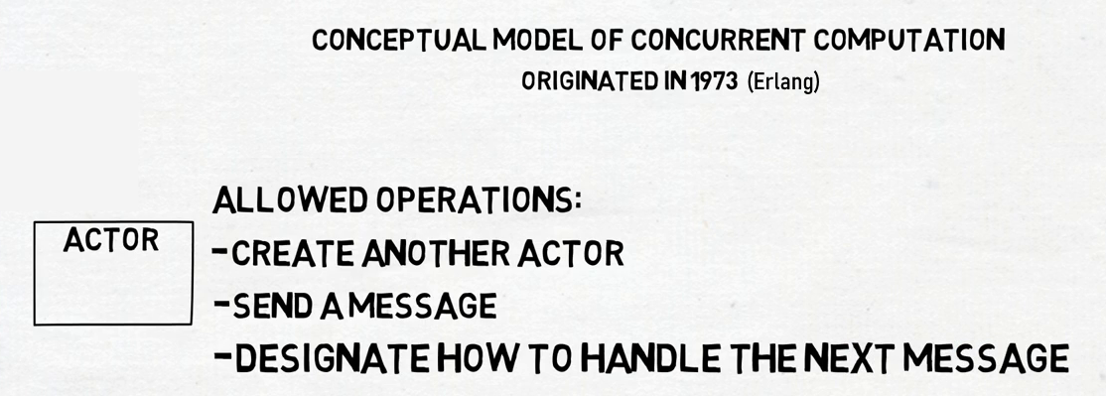
What is the Actor Model?

Slide 5
Properties of an actor
Message: is a unit of communication between actors and it should be immutable.
Mailbox: is used to buffer messages, because the actor’s states are not modified by other actors, thus they send messages to another actor.
Actor Reference: Each actor has an actor reference which is the facade between actors, is freely shared among actors by message passing.
Dispatcher: is a component ensuring actors with non-empty mailboxes eventually get run by a specific thread and that these messages are handled serially.

Slide 6
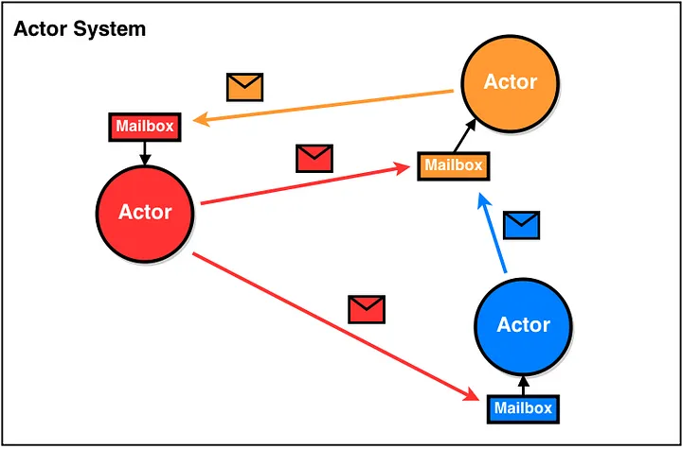

Slide 7
What can an actor do?
Create more actors.
Send messages to other actors.
Designate what to do with the next message.

Slide 8
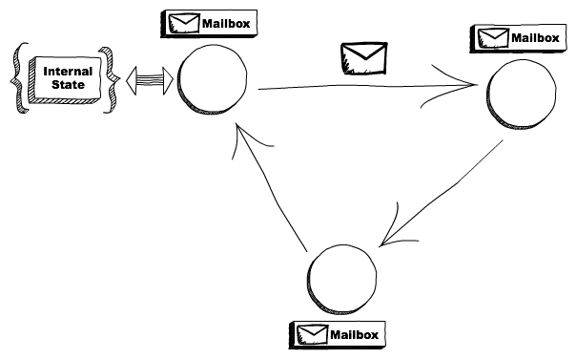
Actors have mailboxes
It’s important to understand that, although multiple actors can run at the same time, an actor will process a given message sequentially.

Slide 9
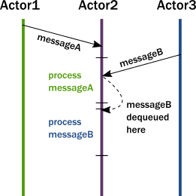
what happens when an actor receives a message

Slide 10
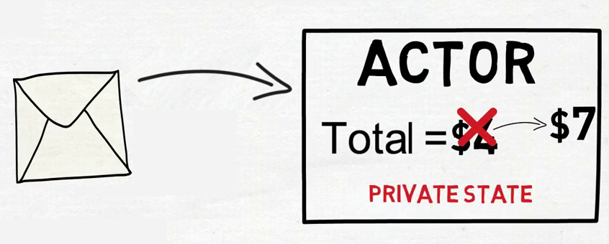
Actor behavior and state
An Actor changes its State upon receiving an incoming message

Slide 11
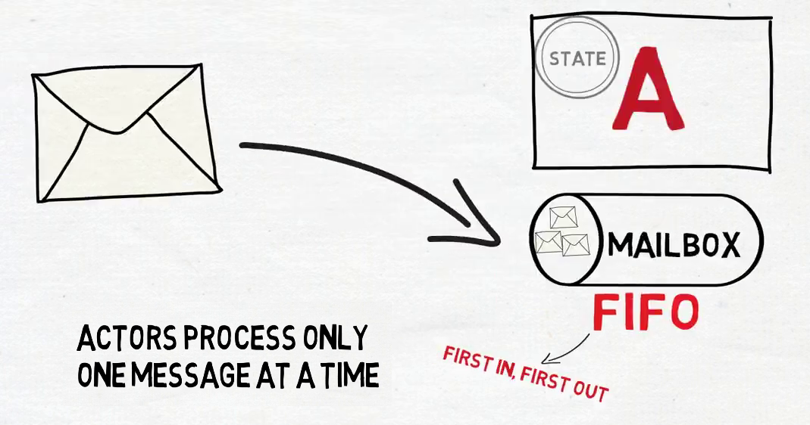

Slide 12
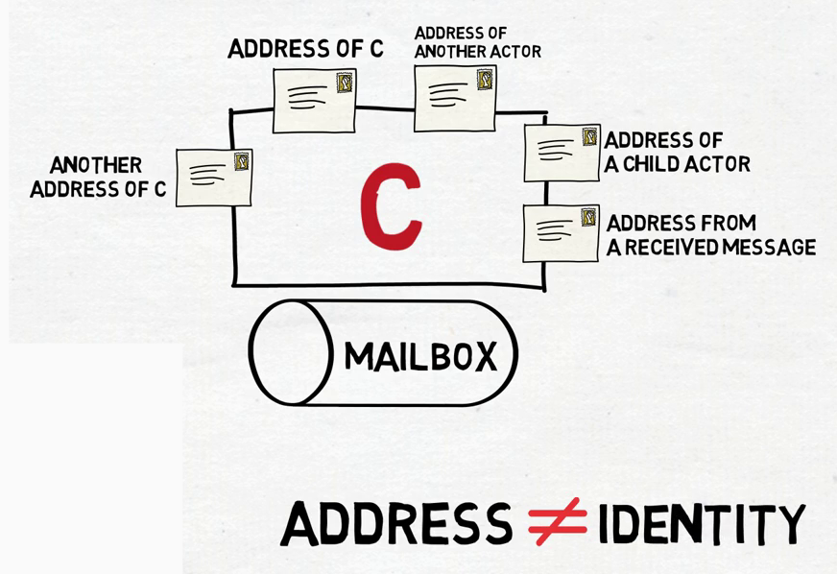

Slide 13
How actors send message and handle message?

Slide 14
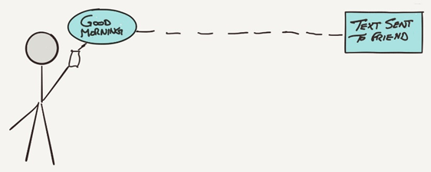
Actor Messaging

Slide 15
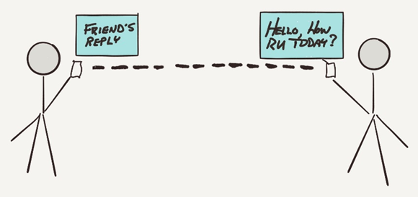
Actor Messaging

Slide 16
What happens when there is no response?

Slide 17
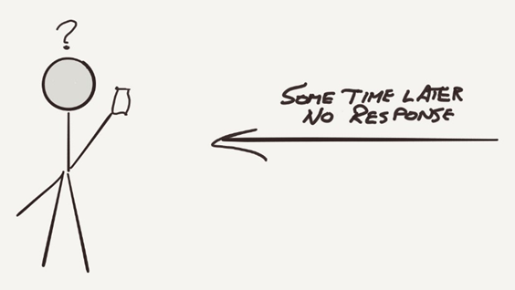
No Response

Slide 18
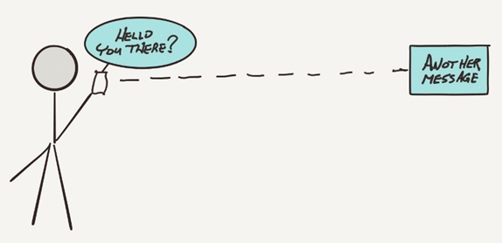
Send Another Message

Slide 19
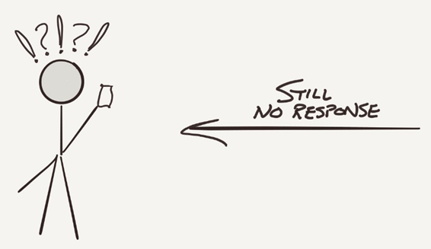
Still No Response

Slide 20
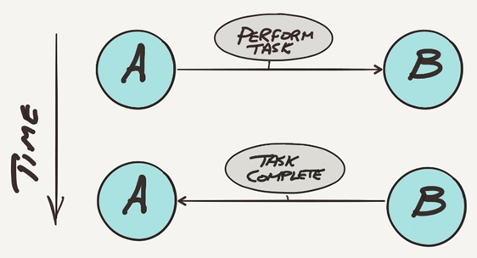
Ideal Situation

Slide 21
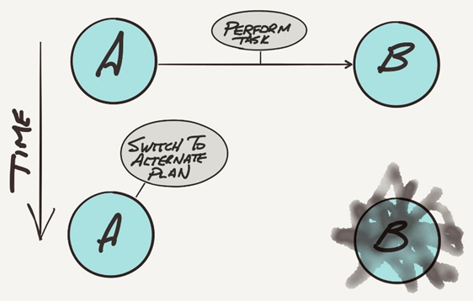
Alternate Plan

Slide 22
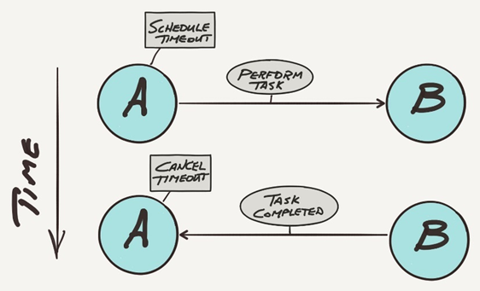
Timeout Cancelled

Slide 23
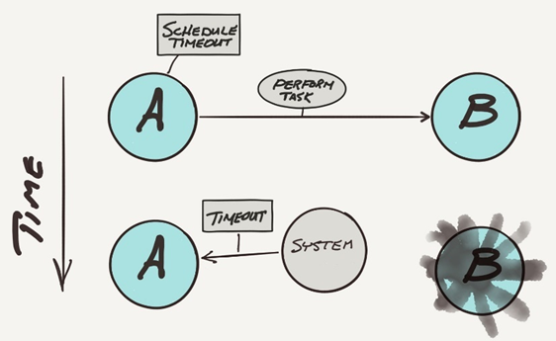
Timeout Expired

Slide 24
Supervisors

Slide 25
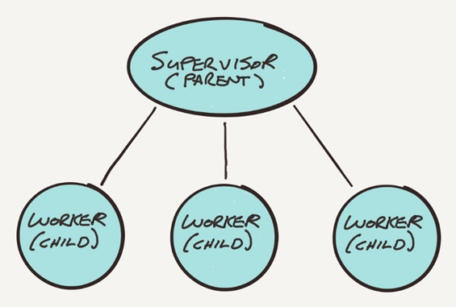
Supervisor actor creates worker actors

Slide 26
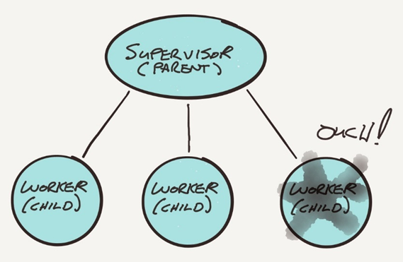
Worker actor has problem and notifies its supervisor

Slide 27
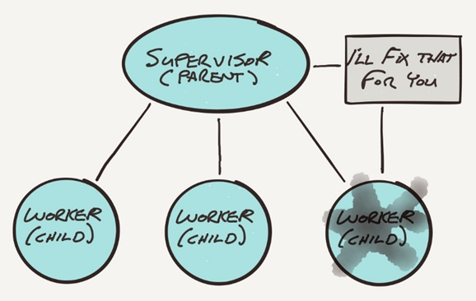
Supervisor fixes problem

Slide 28
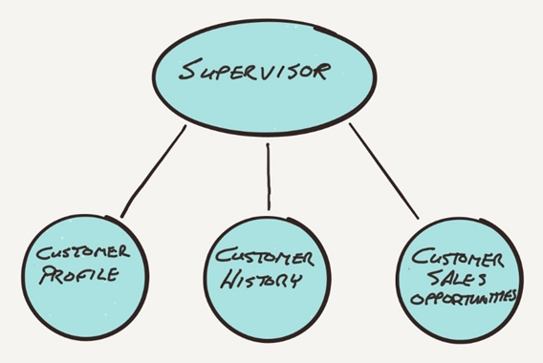
Supervisor actor delegates tasks to worker actors

Slide 29
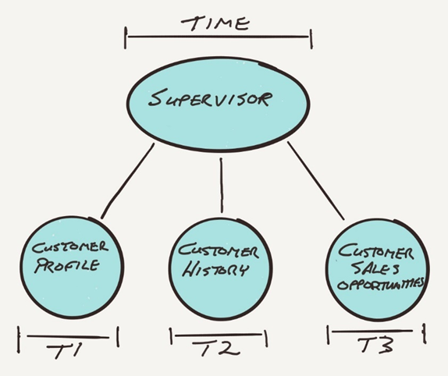
Worker actors perform tasks asynchronously

Slide 30
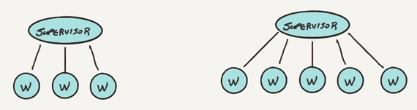
Actors and Scaling
Supervisor adds more worker actors as the processing load increases

Slide 31
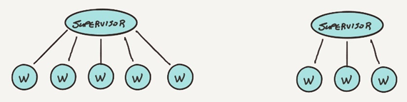
Actors and Scaling
The supervisor sheds workers as the load decreases

Slide 32
Scaling Large Systems
Actors exist within an actor system
Actor system provides the protocol for messaging between actors
It also manages actor activities by allocating the system resources needed to support the actor environment.

Slide 33
Resources in a Computer System
Every computer system has a set of processing cores, memory, disk space, network interfaces, and so on
When programs run, the work is handled by a thread of execution.
With limited number of CPU cores and limited memory, there will be limited number of threads available.
The number of cores and the amount of memory determine how much work or threads a computer system is capable of handling.
This is similar to a room. Depending on the size of an office, more workers will fit in the room if it is larger, which means it can handle more work (threads).

Slide 34
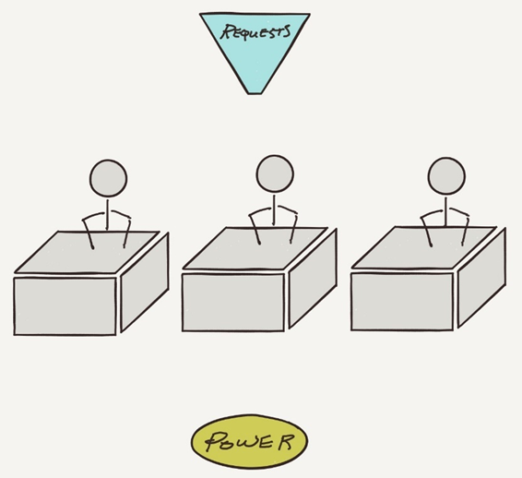
How Actors Manage Requests
An office example where workers sit at desks to perform tasks only when the desk has power

Slide 35
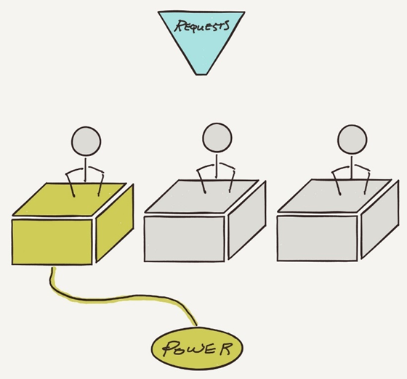
Requests Example
One desk has power, so the worker at that desk may work on its assigned task

Slide 36
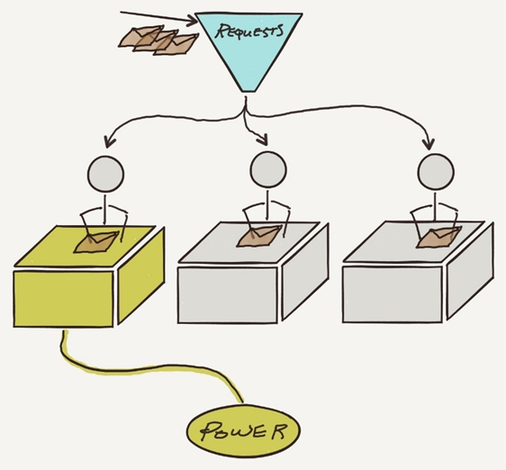
Requests Example
Messages are sent to the office and then routed to each worker

Slide 37
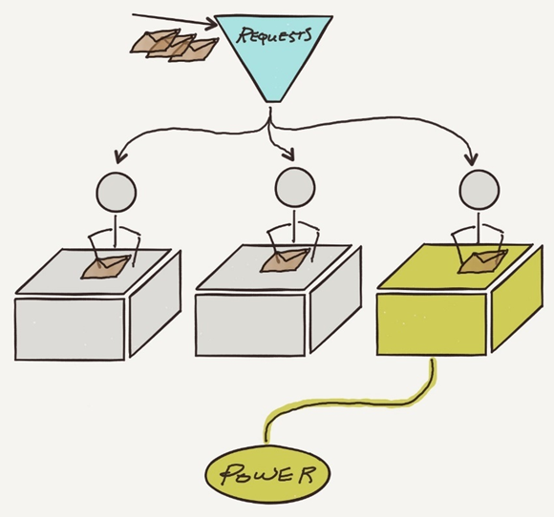
Requests Example
The system swaps the power between desks to allow an even distribution of work

Slide 38
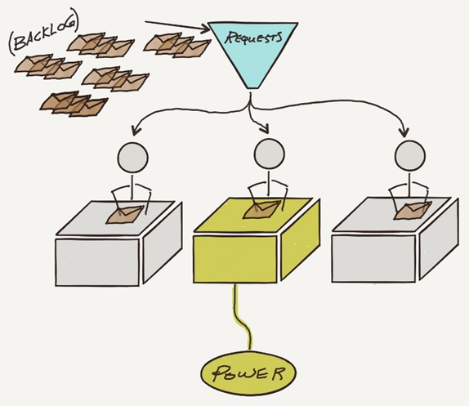
Traditional Threaded System
When messages arrive faster than the workers can perform each task, then there is a backlog of pending messages that are either queued or discarded

Slide 39
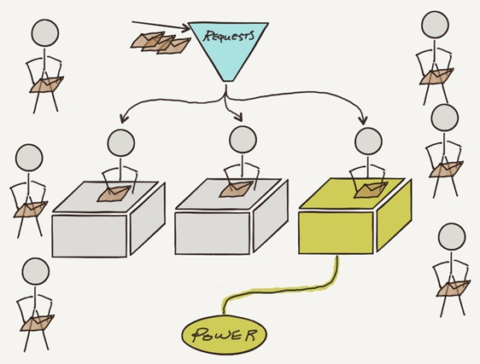
Asynchronous
In an asynchronous system, workers only occupy desks when they have something to do

Slide 40
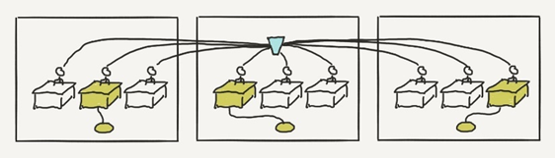
Actor Clusters
Actor systems may run in a cluster

Slide 41
Failure Detection and Recovery
There are a number of strategies available both at the actor level and at the actor system level.
Actors that create other actors are supervisors, and for error handling supervisors are notified when a worker hits a problem, and there are four common recovery steps:
Ignore the error and let the worker resume processing
Restart the worker and perform a worker reset
Stop the worker
Escalate the problem to the supervising actor of the supervisor
How a supervisor handles problems with a worker is not limited to these four recovery options, but other strategies may also be used when necessary.

Slide 42
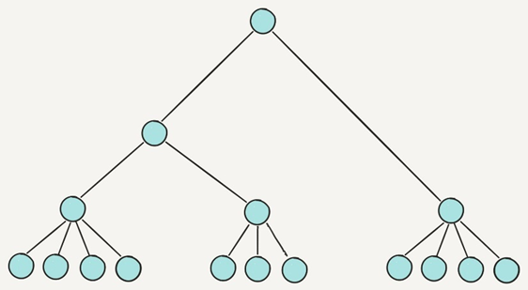
Actors form hierarchies

Slide 43
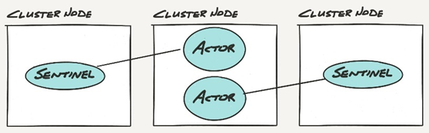
Actors Watching Actors
Sentinel actors watch actors on other nodes in the cluster

Slide 44
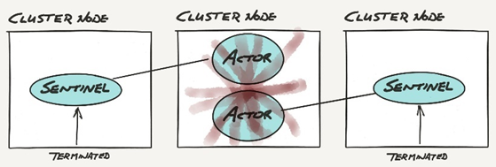
Actor Failure
When a node fails, the sentinel actors are notified via an actor terminated message

Slide 45
Akka Framework

Slide 46
Akka
Akka is a open-source library or a toolkit
It is used to create concurrent, distributed and fault-tolerant application
It implements Actor Based Model
Akka creates a layer between the actors and the underlying system such that actors simply need to process messages
The framework handles the creating and scheduling of threads, receiving and dispatching messages, and handling synchronization.

Slide 47
The Reactive Manifesto
Akka adheres to the The Reactive Manifesto.
Reactive applications aim at replacing traditional multithreaded applications with an architecture that satisfies one or more of the following requirements:
Event-driven.
Scalable.
Resilient.
Responsive.

Slide 48
Event-driven.
Using Actors, one can write code that handles requests asynchronously and employs non-blocking operations exclusively.
Scalable.
In Akka, adding nodes without having to modify the code is possible, thanks both to message passing and location transparency.
Resilient.
Any application will encounter errors and fail at some point in time. Akka provides fault tolerance strategies to facilitate a self-healing system.
Responsive.
Many of today’s high performance and rapid response applications need to give quick feedback to the user and therefore need to react to events in an extremely timely manner. Akka’s non-blocking, message-based strategy helps achieve this.

Slide 49
Actor
An actor is essentially nothing more than an object that receives messages and takes actions to handle them. An actor is an entity which communicates to other actor by message passing
Actor has its own state and behavior.
As in object-oriented programming everything is an object same like everything is an actor in actor-based system.
It is decoupled from the source of the message and it's only responsibility is to properly recognize the type of message it has received and take action accordingly.
Upon receiving a message, an actor may take one or more of the following actions:
Execute some operations itself (such as performing calculations, persisting data, calling an external web service, and so on)
Forward the message, or a derived message, to another actor
Instantiate a new actor and forward the message to it
Alternatively, the actor may choose to ignore the message entirely (i.e., it may choose inaction) if it deems it appropriate to do so.

Slide 50
How to create an Actor?
To implement an actor, extend the akka.actor.AbstractActor class and implement the createReceive() method.
An actor’s createReceive() method is invoked when a message is sent to that actor.
Its typical implementation is to identify the message type and react accordingly
If a message is not matched, it is logged in Akka event logs
A catch-all matchAny() can be used to match any message.

Slide 51
Akka Actor class
public class ActorA extends AbstractActor {
@Override
public Receive createReceive() {
return receiveBuilder()
.match(MessageA.class, this::onMessageA)
.build();
}
private void onMessageA(MessageA msg) {
System.out.println("Actor A received : "+ msg.text + " from " + getSender());
}
}

Slide 52
Akka ActorSystem
The ActorSystem is a root actor in actors structure.
An ActorSystem is a hierarchical group of actors which share common configuration, e.g. dispatchers, deployments, remote capabilities and addresses.
It is also the entry point for creating or looking up actors.
It is an abstract class which extends to ActorRefFactory trait.

Slide 53
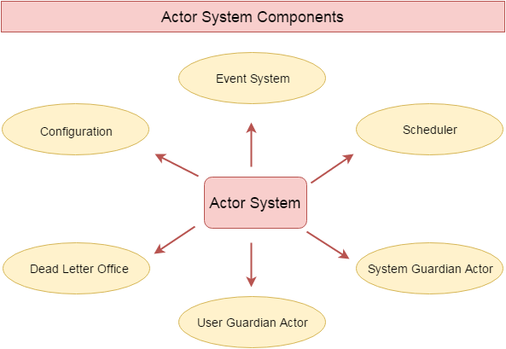

Slide 54
Akka Props
Props is a configuration class used to create actors
You can implement Props by importing akka.actor.Props package.
public static void main(String[] args) {
ActorSystem system = ActorSystem.create();
ActorRef actorARef = system.actorOf(Props.create(ActorA.class));
actorARef.tell(new MessageA("Hello!"),actorARef);
}

Slide 55
Akka Creating Child Actor
Akka provides facility to create child actor.
You can create child actor by using implicit context reference.
ActorSystem is used to create root-level or top-level actor.
getContext().getSystem().actorOf(Props.create(ActorB.class));

Slide 56
Akka Actor life cycle
Akka provides life cycle methods for Actor.
There are following methods to which you can override and provide specific implementation accordingly.
preStart()
postStart()
preRestart(reason: Throwable, message: Option[Any])
postRestart(reason: Throwable))

Slide 57
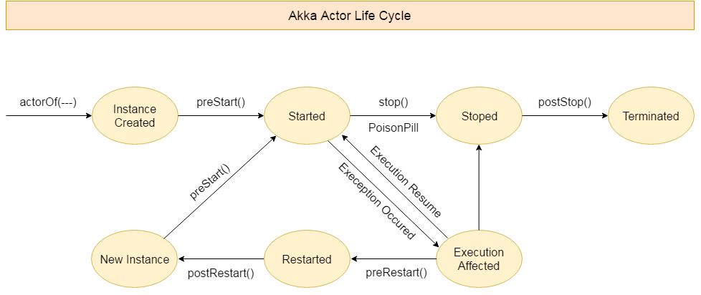

Slide 58
Akka Actor Communication
In Akka, actors communicate to each other by sending and receiving messages.
Akka Actor Send Messages
Akka Actor Reply Messages
Akka Actor Forward Messages

Slide 59
Akka Actor Send Messages
Akka provides two predefined methods tell() and ask() for message exchange. An actor can send messages to another Actor through these methods.
Receiver.tell(Message object, Sender);
Receiver.ask(Message object, Sender);

Slide 60
Akka Actor Reply Messages
You can reply to a message by using sender() method
getSender().tell(Message object,getSelf())

Slide 61
Actor Forward Message
You can forward a message from one actor to another.
In this case, address/reference of an Actor is maintained even though the message is going through a 'mediator'.
It is helpful when writing actors that work as routers, load-balancers, replicators etc.
target.forward(result, getContext());

Slide 62
Receiving messages
public Receive createReceive() {
return receiveBuilder()
.match(String.class,
s -> System.out.println(s)).build();
}

Slide 63
Stopping Actors
you can stop Actors by invoking the stop() method of either ActorContext or ActorSystem class
getContext().stop(child));
ActorContext is used to stop child actor and ActorSystem is used to stop top level Actor.
Termination of the actor is performed asynchronously.
There are some other methods available in Akka, which are used to stop Actor. Some of which are PoisonPill, terminate() and gracefulStop() are used to stop Actor.

